Slide 1
Badminton Swing Analyzer
using
MPU6050 with ML
Batch –B2
Team Members
Aswin Raaj .R
Mani Balaji .S
Tharun .V.S
Guided by
Dr.G.Pandiaraj
Assistant Professor (Sl. Grade)
Electrical and Electronics Engineering
MSEC, Sivakasi

Slide 2
Project Overview
Problem Statement:
Traditional badminton training is largely dependent on subjective coaching and visual observation, leading to inconsistent performance evaluation
There is a lack of an intelligent and automated system to accurately analyze swing quality, stroke classification, and player efficiency in real time
Motivation:
To integrate embedded systems and machine learning for intelligent sports performance tracking.
To provide feedback for improving player technique and training efficiency.
Objective:
To design a smart system that detects and classifies badminton strokes using sensor data and AI models.
To analyze player performance metrics such as speed, impact, power, and consistency in real time.

Slide 3
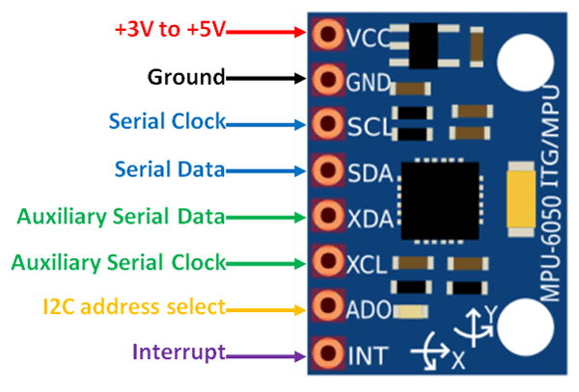
MPU6050 IMU Sensor
Working Principle:
The MPU6050 is a 6-axis IMU sensor combining:
3-axis Accelerometer
3-axis Gyroscope
Accelerometer measures linear motion along X, Y, Z axes
Gyroscope measures angular rotation of the racket
Data Processing:
Sensor outputs raw data via
I2C communication to ESP32
Acceleration + angular velocity are continuously monitored
Total acceleration is computed to detect swing motion
Role in Project:
Detects start and end of badminton swings
Captures motion characteristics like:
Speed
Impact
Direction
Provides input for feature extraction and ML models

Slide 4
Swing Detection Algorithm
Working Logic:
Continuously read accelerometer & gyroscope data
Compute total acceleration magnitude
If acceleration > START_THRESHOLD → Start swing
Track peak speed and maximum impact during motion
If acceleration < END_THRESHOLD AND duration > MIN_DURATION →End swing
Store swing data for further processing
Parameters ( Tuned ):
START_THRESHOLD → detects swing beginning
END_THRESHOLD → detects swing completion
MIN_DURATION → removes false short movements
COOLDOWN → avoids duplicate detection
Ensures only valid badminton strokes are captured
Removes noise from random hand movement
Forms the foundation for ML accuracy

Slide 5
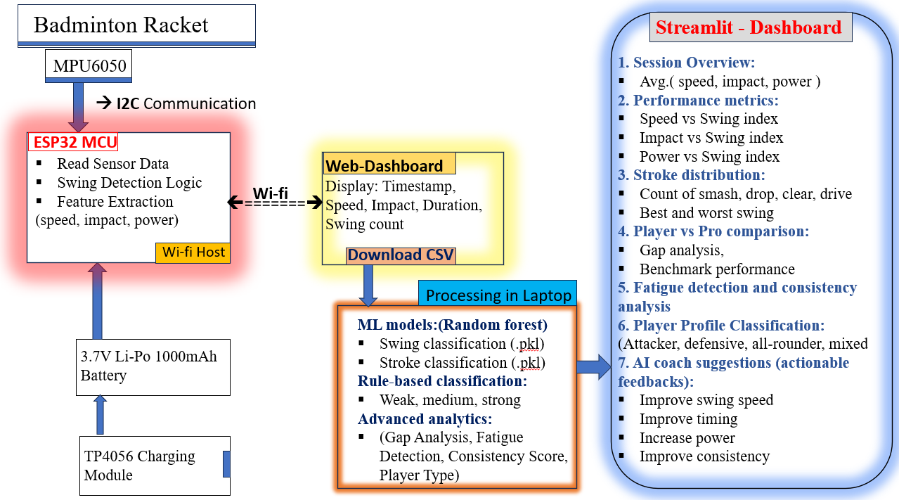
Block Diagram

Slide 6
Feature Engineering & Calibration
Feature Engineering:
Raw IMU data is converted into meaningful features
Key features extracted:
Speed (from ang. velocity)
Impact (from acc. magnitude)
Duration (swing time)
Derived features:
Power = Speed × Impact
Efficiency = Impact / Duration
Calibration (Personalized Thresholding):
First 30 swings recorded in calibration mode
Used to create player-specific baseline
Thresholds computed using:
25th percentile → Weak threshold
75th percentile → Strong threshold
Classification Logic:
Power < Weak Threshold → WEAK
Power between thresholds → MEDIUM
Power > Strong Threshold → STRONG

Slide 7
Machine Learning Pipeline (Training & Data)
Data Sources :
Real Sensor Data -
Collected using ESP32 + IMU during gameplay
Includes speed, impact, duration
Synthetic Data (MATLAB Generated) -
Created to simulate different swing patterns
Used to balance dataset and improve robustness
Synthetic Data Logic (MATLAB) :
Generate signals based on:
Acceleration patterns
Angular velocity variations
Apply:
Noise injection
Scaling (weak → strong swings)
Time variation (fast vs slow strokes)
To Simulates realistic badminton swings
Data Augmentation :
Combine real + synthetic data
Improves -
Model generalization
Accuracy across players
Handling of edge cases
Final Dataset :
Features -
Speed, Impact, Duration
Power, Efficiency
Acceleration & Gyro metrics

Slide 8
ML Models & Deployment
Algorithm: Random Forest Classifier
Ensemble learning method using multiple decision trees
Improves accuracy through majority voting
Robust against noise and overfitting
Swing Classification Model
Input Features: Speed, Impact, Power, Efficiency
Output Classes: WEAK / MEDIUM / STRONG
Learns patterns in swing strength and performance quality
Stroke Classification Model
Input Features: Acceleration magnitude, Gyro magnitude, Peak values, Energy
Output Classes: SMASH / DROP / CLEAR / DRIVE
Identifies type of badminton stroke based on motion patterns
Training Process :
Supervised learning using labelled dataset
Input: engineered features
Model learns patterns between motion and stroke type
Model Deployment :
Trained models saved as .pkl files
Loaded in Python using joblib
Used for real-time prediction after each swing

Slide 9
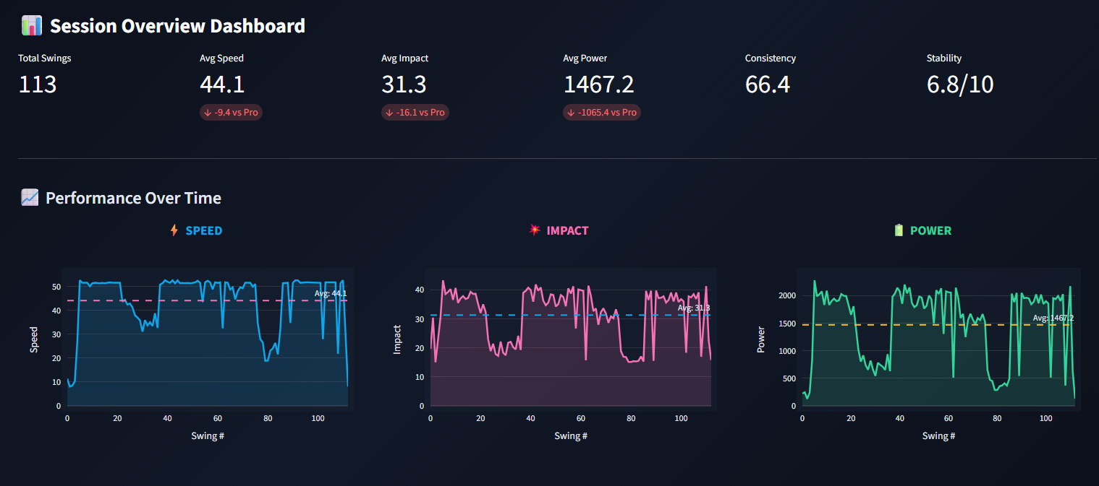
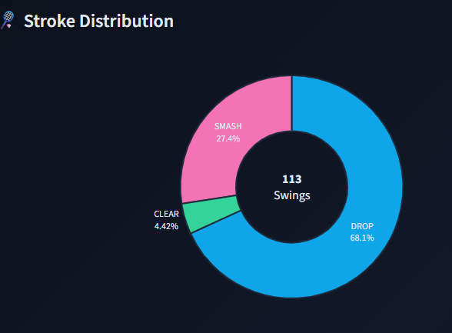
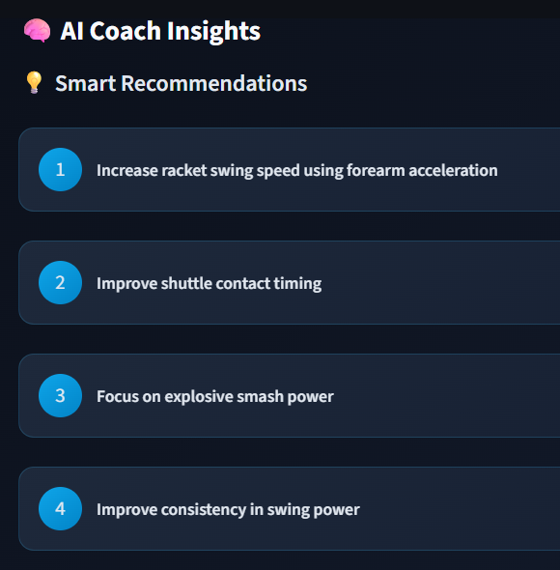
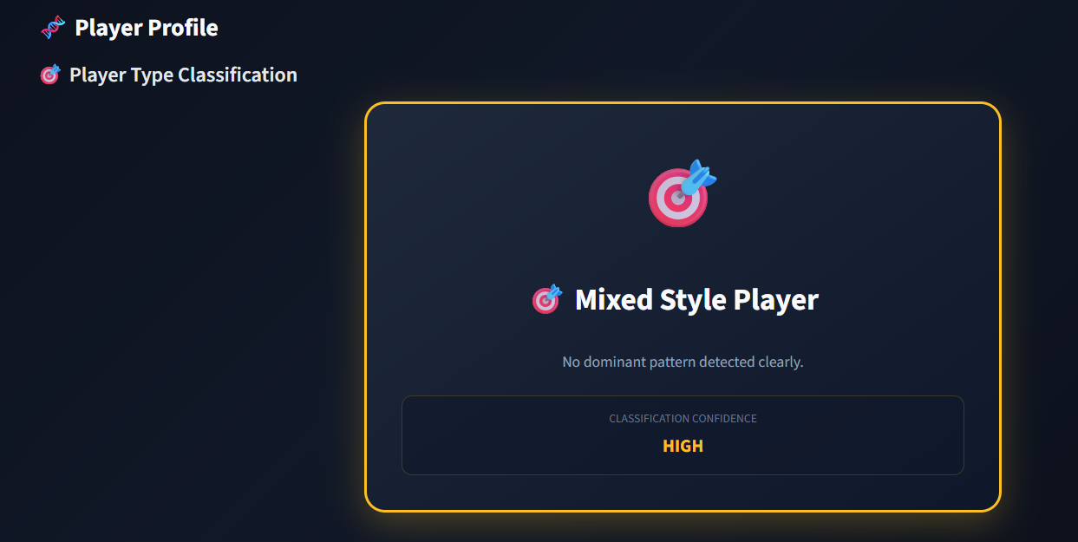
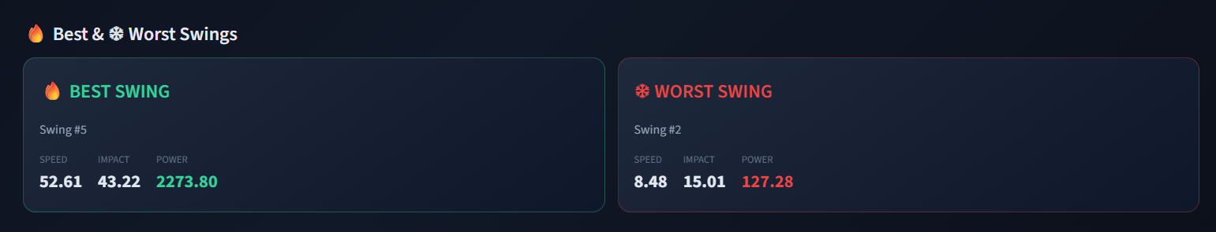
Results

Slide 10
Key Innovations
Hybrid Classification Approach :
Combines threshold-based detection with ML prediction
Ensures high reliability + intelligent decision making
Improves system accuracy
Personalized Calibration System :
Uses first 30 swings as baseline data
Generates dynamic, player-specific thresholds
Adapts to different playing styles automatically
Synthetic Data Augmentation :
MATLAB-generated realistic swing data
Includes noise, variation, and scaling effects
Improves model generalization and robustness
Dual Machine Learning Models :
Swing Model → Weak / Medium / Strong
Stroke Model → Smash / Drop / Clear / Drive
Enables multi-level performance analysis

Slide 11
Key Challenges & Solutions
S.no | Challenges Faced | Solutions Implemented
1. | Sensor saturation during high-impact smashes | Applied threshold tuning and signal scaling
2. | Noise and drift in IMU data | Used Kalman filtering and gravity compensation
3. | Offset calibration instability | Implemented proper sensor offset correction
4. | Swing boundary detection (start/end) | Designed threshold + duration-based algorithm
5. | False swing detection (random movements) | Added minimum duration and cooldown logic
6. | Limited real-world dataset | Generated synthetic data using MATLAB
7. | Model generalization across players | Used personalized calibration (first 30 swings)

Slide 12
Future Scope & Next version (v3.0)
Need for upgrade :
Improved measurement accuracy
Reduced power consumption
Significant weight reduction
Enhanced real-time performance
Seeed XIAO nRF52840 (MCU)
Has deep sleep mode
Ultra-low power → longer battery life
Native Bluetooth (BLE)→direct mobile connectivity
ICM42688 IMU Sensor
Higher accuracy & lower noise than MPU6050
Better motion tracking for fast swings
200 mAh Li-Po Battery
Compact and lightweight design
Optimized for wearable usage
System Enhancement
Bluetooth Low Energy (BLE) data streaming – low latency
Direct integration with mobile app / offline web app
No need for Wi-Fi hotspot (portable system)
Product Vision
Real-time coaching via mobile interface
Scalable for sports analytics platforms

Slide 13
Current prototype vs next version (v3.0)
Feature | Current Prototype | v3.0
MCU | ESP32 | Seeed XIAO nRF52840
Sensor | MPU6050 | ICM42688
Connectivity | Wi-Fi | BLE
Battery | 1000 mAh | 200 mAh
Avg Current | ~100 mA | ~13 mA
Battery Life | 6 – 10 hrs | 12 – 14 hrs
Weight | ~50 g | ~15 g

Slide 14
Next Version (v3.0)
ICM42688
(IMU)
Seeed XIAO studio nRF52840 microcontroller
Push button: (Calibration mode, Game mode ), LEDs
3.7V Li-Po 200mah battery,
TP4056 charging module

Slide 15
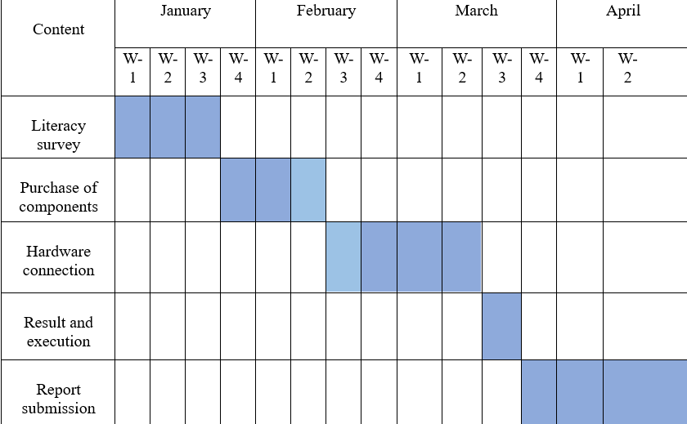
Gantt Chart

Slide 16
References
Rodrigues, João Victor Oliveira, et al. "Performance evaluation of accelerometers ADXL345 and MPU6050 exposed to random vibrational input." Research, Society and Development 10.15 (2021): e286101523082-e286101523082.
Fedorov, D. S., et al. "Using of measuring system MPU6050 for the determination of the angular velocities and linear accelerations." Automatics & Software Enginery 11.1 (2015): 75-80.
Jacob, Alvin, Wan Nurshazwani Wan Zakaria, and Mohd Razali Bin Md Tomari. "Implementation of IMU sensor for elbow movement measurement of badminton players." 2016 2nd IEEE International Symposium on Robotics and Manufacturing Automation (ROMA). IEEE, 2016.
Li, Li, and Feng Li. "Recognizing badminton hitting movements Based on Multi-sensor trajectory recognition algorithm." 2023 3rd International Conference on Information Technology and Contemporary Sports (TCS). IEEE, 2023.
https://ijsrst.com/home/issue/view/article.php?id=IJSRST52310620
https://pubmed.ncbi.nlm.nih.gov/38580698/
http://www.jurnal.nips.ru/sites/default/files/A&SE-1-2015-11_0.pdf

Slide 17
Thank You

